Slide 1
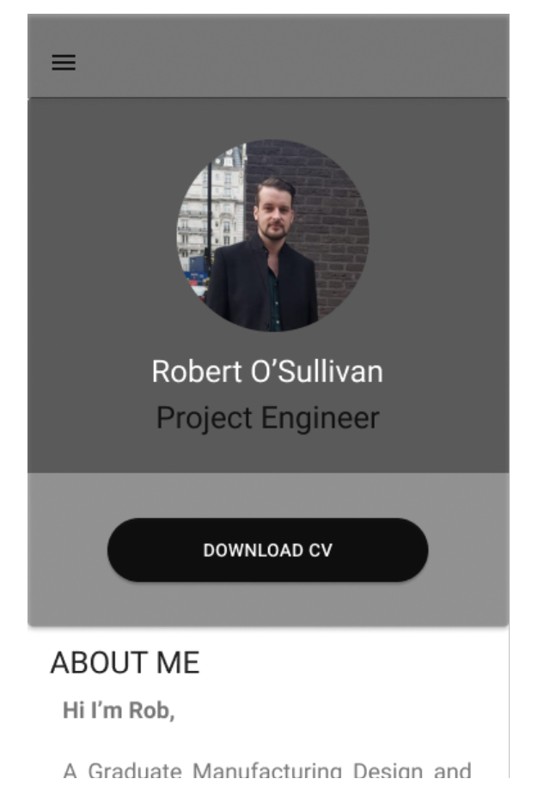
C=User clicks button to download word document
User presses and holds to scroll down

Slide 2
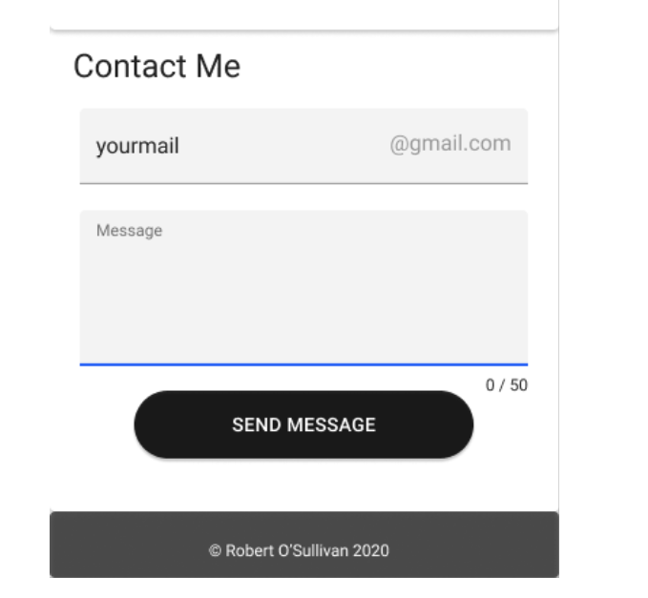
Form gives user an idea of what can be entered in this text box and validation checks if email is entered correctly
Status bar informs user which box is highlighted
Encourages user to keep message short
When pressed a message will appear showing summary and giving the option to cancel

Slide 3
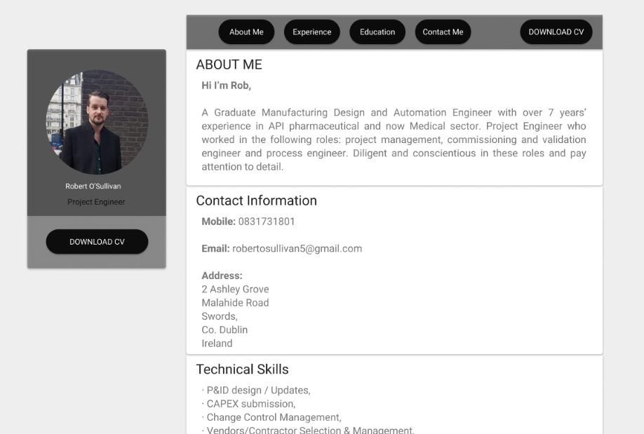
Download button at top right as a quick call to action. It’s kept separate from other navigation buttons
Profile picture and call to action button is sticky and will follow as the user scrolls.
Current position displayed to remove having to recall.

Slide 4
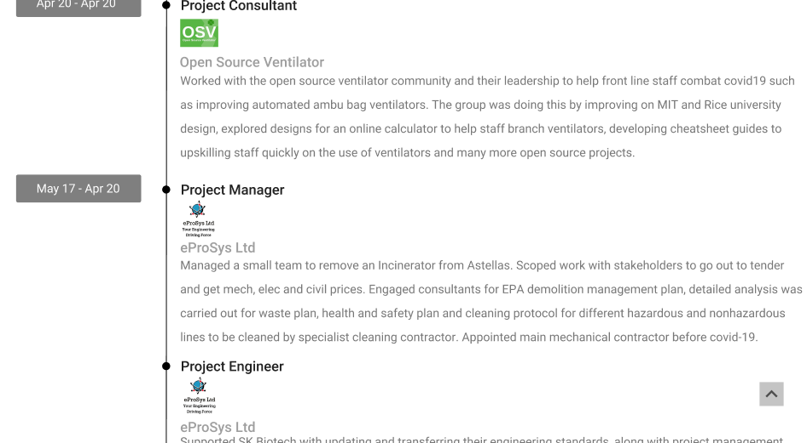
Arrow to allow the user to jump back to the top appears as they scroll down

